Slide 1
Food Map

Slide 2
01
Production process of an apricot jam
02
Where are the main ingredients coming from?
03
Where is the packaging coming from?
04
Jam food system map

Slide 3
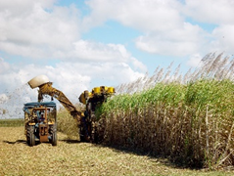
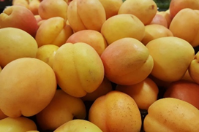
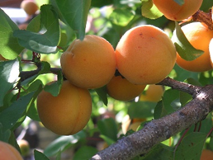
Production process of an apricot jam
Sugar cane
Sugar production factory
Transporting sugar to jam making factory
Transporting
Source (photo): Free Images
Grading/sorting
√
X
Apricots mixed with sugar (and any other ingredients)
Picking apricots at the apricot tree field
Cutting / seed removal
Transporting
washing
Source (photo): Pixabay
Source (photo): Free Images
Selling points (e.g. supermarkets, restaurants, etc.)
Transporting
Packaging the jam
Heating

Slide 4
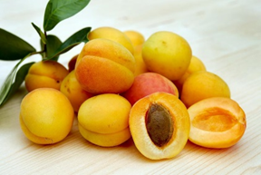
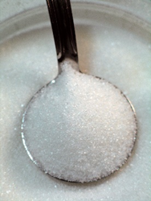
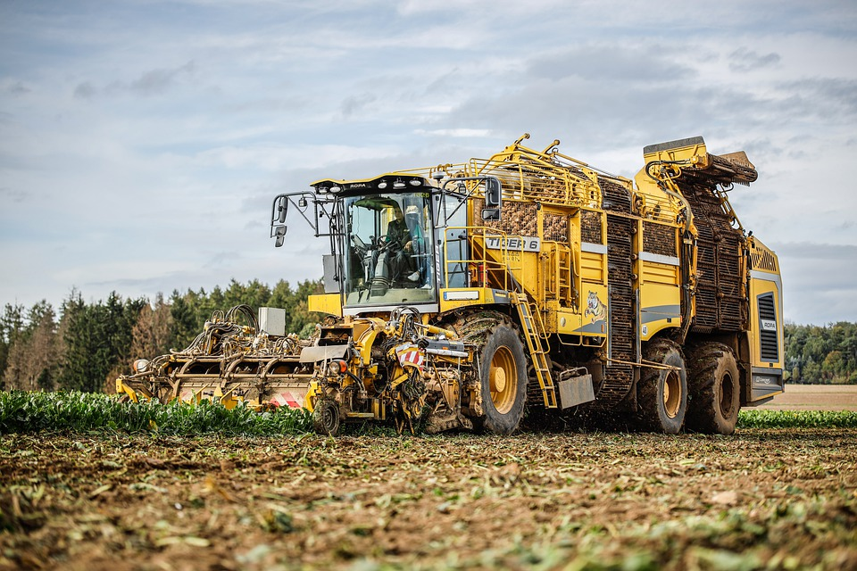
Where are the main ingredients coming from?
A. Fruit
Source (photo): Free Images
Sugar cane
Source (photo): Pixabay
Energy
B. Sugar
Source (photo): Free Images
Sugar processing factory
Sugar beet
Sugar cane or sugar beet processing factory
https://www.eufic.org/en/food-production/article/sugar-how-is-produced-from-cane-infographic
Source (photo): Free Images
Source (photo): Pixabay

Slide 5
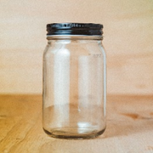
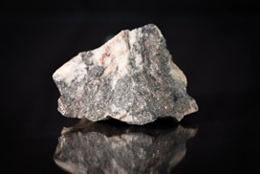
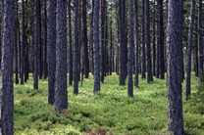

Where is the packaging coming from?
Energy
Ore/aluminium
Glass jar
with
metal lid
Energy
Natural resources (non-renewable)
Source (photo): Unsplash
Sand
Source (photo): Unsplash
Plants
Energy
Labels
Energy
Cardboard boxes
Source (photo): Free Images
Source (photo): Pixabay

Slide 6


Jam food system map
Source (photo): Pixabay
Source (photo): Free Images
Source (photo): Free Images
Source (photo): Free Images
Labels
Source (photo): Pixabay
Source (photo): Unsplash
Sand
Source (photo): Free Images
Source (photo): Unsplash
Source (photo): Pixabay

Slide 7


Q&A
Follow us on

Slide 8
Thank you!

